Slide 1

CS302 Design and Analysis of Algorithms
Muhammad sohail afzal

Slide 2
Video Link of this lecture
Video Link Lecture:
https://drive.google.com/file/d/1TRPgoD30rkP7D6dYM_5_Ju_E2wTDNcJY/view?usp=sharing

Slide 3
Cook’s Theorem
We need to have at-least one NP-Complete problem to keep the ball rolling.
Stephen Cook showed that such problem exists.
He said “SAT Problem (Boolean Satisfiability Problem) is NP-complete problem”. This is Cook’s theorem and he used turing machines in early 70’s and proved that SAT problem is NP-complete problem

Slide 4
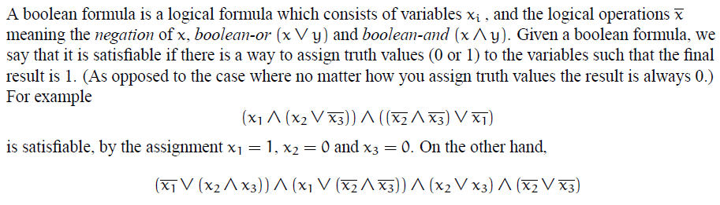
Cook’s Theorem
SAT problem is stated as follows:

Slide 5
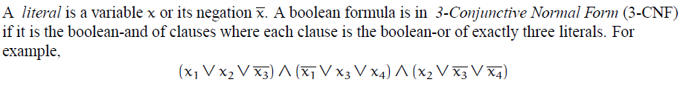
Cook’s Theorem
Even a more reduced version of SAT problem is also NP-complete. 3CNF is reduced form of SAT problem and it is also NP-complete
Above expression is 3CNF SAT form where is one clause that has three literals. So above expression has 3 clauses with 3 literals in each. As each clause is separated by “And operation” so answer to this complete expression will evaluate to true if each clause will evaluate to true.

Slide 6
Reduction Example 2: Reducing 3CNF SAT to Clique decision problem
In previous lecture, we have seen reduction of 3 graph coloring problem to Clique cover problem which is reduction example 1.
Here we will be reducing 3CNF problem to clique problem (clique decision problem) to show that clique decision problem is also NP-Complete problem.
Please note that clique problem(clique decision problem) is different from clique cover problem that we studied previously.

Slide 7
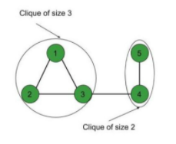
Reduction Example 2: Reducing 3CNF SAT to Clique decision problem
Clique decision problem
In clique decision problem, we have to find whether there exists clique of size “k”. Clique of size “k” means if there exists “k” number of vertices that are making a clique (complete sub-graph)
Like if k=3 then we need to find if there exists 3 number of vertices that are making a clique(complete sub-graph). So for below graph it is YES as it has vertices 1,2 and 3 that are making clique.
Please note that clique problem(clique decision problem) is different from clique cover problem. We saw in previous lecture in clique cover problem that “k” is total number of cliques. But in clique problem(clique decision problem), k is total number of vertices that are making a clique.

Slide 8

Reduction Example 2: Reducing 3CNF SAT to Clique decision problem
For example, you want to reduce this expression of 3CNF to clique decision problem :
Where means (negation of x1).
So steps to follow while reducing 3CNF to clique decision problem:
For each clause, create a vertex for each literal
For the edges, connect vertices if they come from different clauses (do not connect vertices in same clause)
No vertex (literal) should be connected to its negation in other clause.

Slide 9
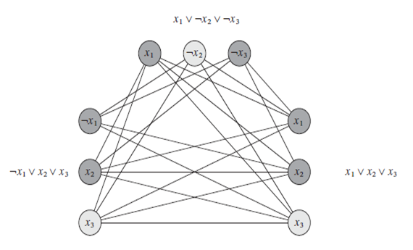
Reduction Example 2: Reducing 3CNF SAT to Clique decision problem
The final graph will look like this :
If k=3 then in above graph we have clique of size 3.

Slide 10
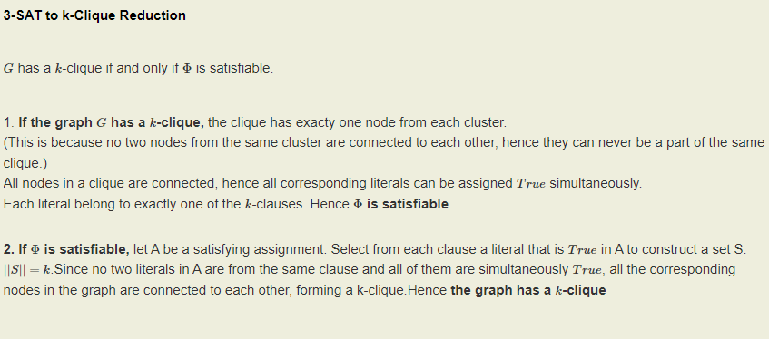
Reduction Example 2: Reducing 3CNF SAT to Clique decision problem

Slide 11
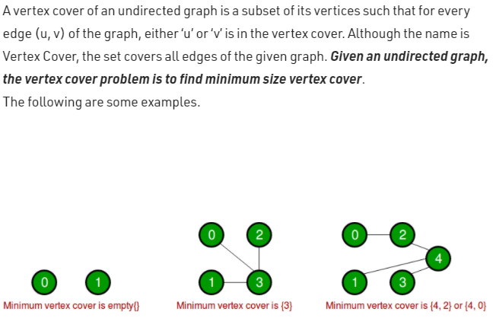
Reduction Example 3: Reducing clique decision problem to vertex cover
Vertex Cover Problem :

Slide 12
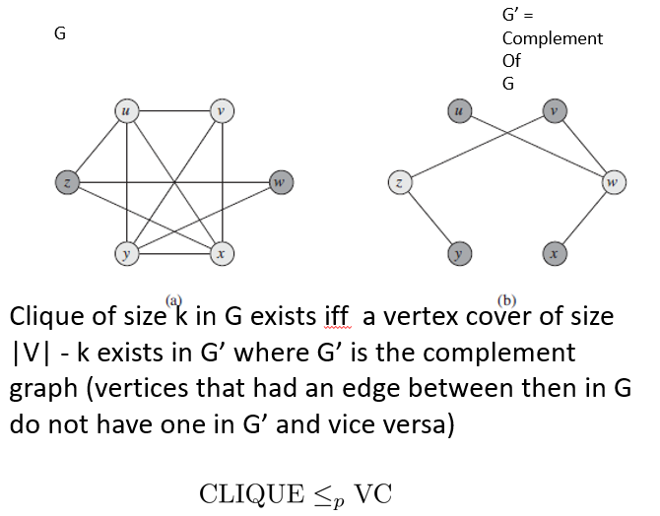
Reduction Example 3: Reducing clique decision problem to vertex cover

Slide 13
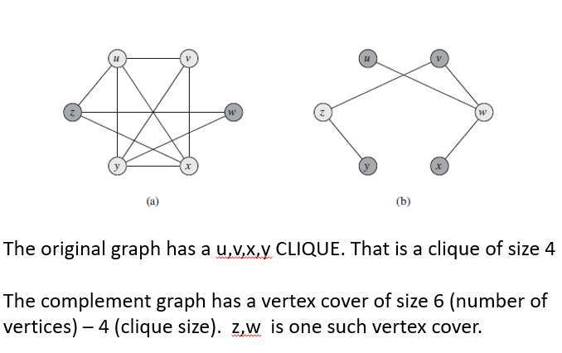
Reduction Example 3: Reducing clique decision problem to vertex cover

Slide 14
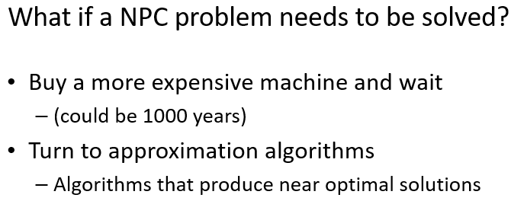
Approximate Algorithms for NPC Problems

Slide 15
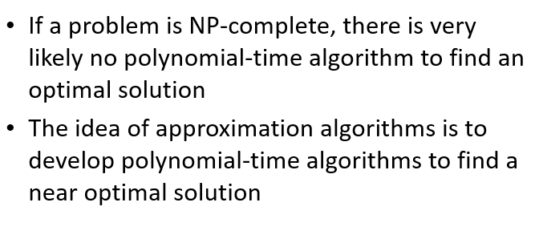
Approximate Algorithms for NPC Problems

Slide 16
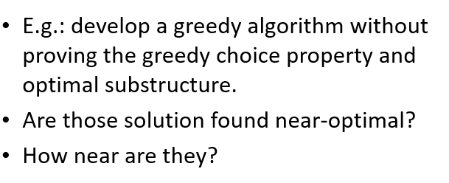
Approximate Algorithms for NPC Problems

Slide 17
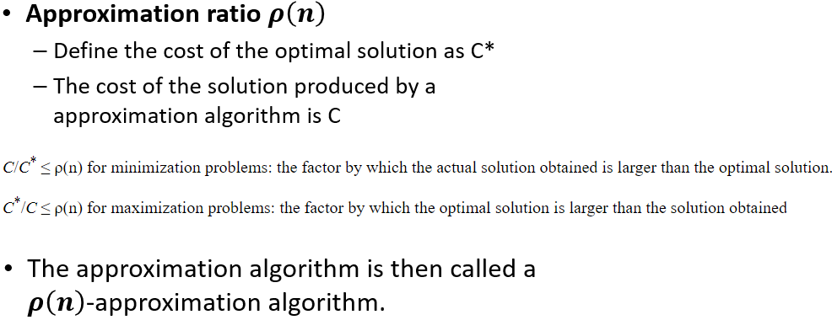
Approximate Algorithms for NPC Problems

Slide 18
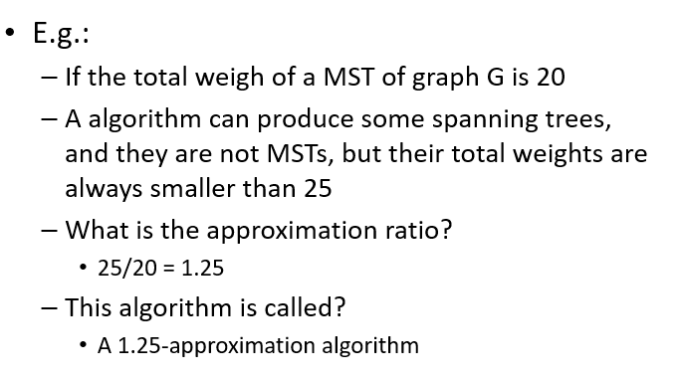
Approximate Algorithms for NPC Problems

Slide 19
Approximate Algorithms for NPC Problems
MST is minimization problem as we need to minimize distance so approximate ratio = C/C*
Maximization problem is problem where we need to maximize something like robot maximize reward question given in mid2 where we need to maximize reward unlike MST. In that case, approximate ratio = C*/C
In short approximate ratio will be greater than 1 as approximate algorithm is near optimal which means it is not better than optimal.

Slide 20
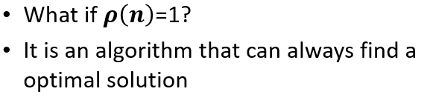
Approximate Algorithms for NPC Problems

Slide 21
2-approximation algorithm for Vertex Cover
A 2-approximation algorithm returns a solution whose cost is at most twice the optimal
Vertex Cover Problem (NP-Complete Problem) :

Slide 22
2-approximation algorithm for Vertex Cover
1
2
3
4
5
6
7
Are the dark brown vertices a vertex-cover?
No. why?
Edges (5, 6), (3, 6) and (3, 7) are not covered by it

Slide 23
2-approximation algorithm for Vertex Cover
1
2
3
4
5
6
7
Are the dark brown vertices a vertex-cover?
No. why?
Edge (3, 7) is not covered by it

Slide 24
2-approximation algorithm for Vertex Cover
1
2
3
4
5
6
7
Are the dark brown vertices a vertex-cover?
Yes
What is the size?
4

Slide 25
2-approximation algorithm for Vertex Cover
1
2
3
4
5
6
7
Are the dark brown vertices a vertex-cover?
Yes
What is the size?
7

Slide 26
2-approximation algorithm for Vertex Cover
1
2
3
4
5
6
7
Are the dark brown vertices a vertex-cover?
Yes
What is the size?
5

Slide 27
2-approximation algorithm for Vertex Cover
1
2
3
4
5
6
7
Are the dark brown vertices a vertex-cover?
Yes
What is the size?
3

Slide 28
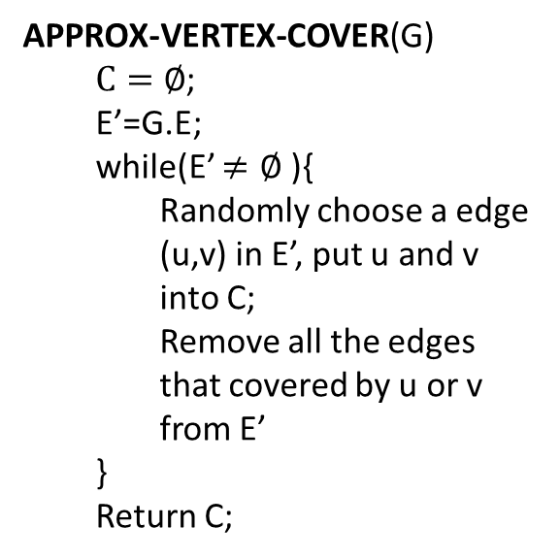
2-approximation algorithm for Vertex Cover
APPROX-VERTEX-COVER(G)
$C=∅$;
E’=G.E;
while(E’ $≠∅$ ){
Randomly choose a edge (u,v) in E’, put u and v into C;
Remove all the edges that covered by u or v from E’
}
Return C;
1
2
3
4
5
6
7

Slide 29
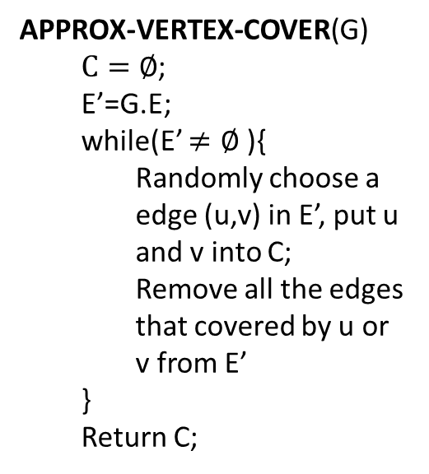
2-approximation algorithm for Vertex Cover
APPROX-VERTEX-COVER(G)
$C=∅$;
E’=G.E;
while(E’ $≠∅$ ){
Randomly choose a edge (u,v) in E’, put u and v into C;
Remove all the edges that covered by u or v from E’
}
Return C;
1
2
3
4
5
6
7
It is then a vertex cover
Approximate cost / optimal cost = 6/3 = 2
Size?
6
How far from optimal one?

Slide 30
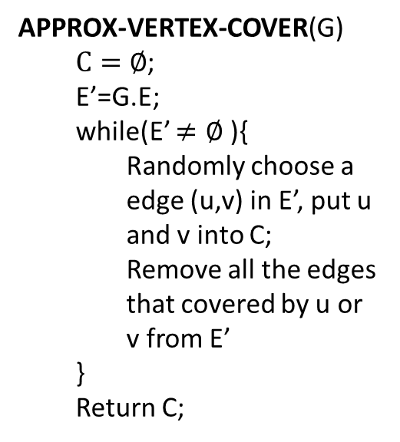
2-approximation algorithm for Vertex Cover
APPROX-VERTEX-COVER(G)
$C=∅$;
E’=G.E;
while(E’ $≠∅$ ){
Randomly choose a edge (u,v) in E’, put u and v into C;
Remove all the edges that covered by u or v from E’
}
Return C;
1
2
3
4
5
6
7

Slide 31
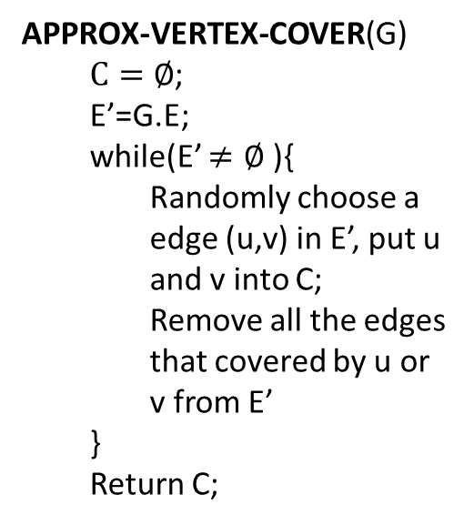
2-approximation algorithm for Vertex Cover
APPROX-VERTEX-COVER(G)
$C=∅$;
E’=G.E;
while(E’ $≠∅$ ){
Randomly choose a edge (u,v) in E’, put u and v into C;
Remove all the edges that covered by u or v from E’
}
Return C;
1
2
3
4
5
6
7
It is then a vertex cover
Size?
4
How far from optimal one?
4/3 = 1.33

Slide 32
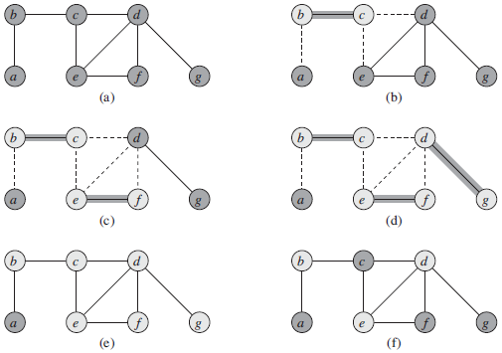
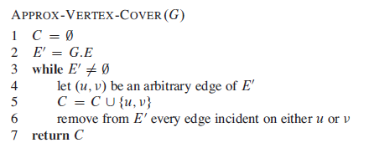
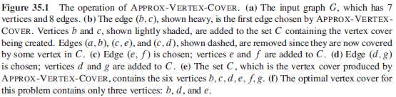
2-approximation algorithm for Vertex Cover

Slide 33
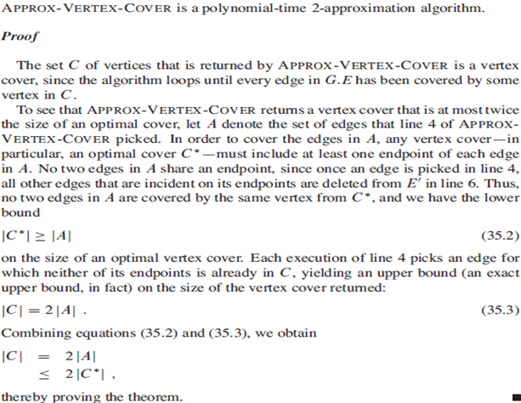
2-approximation algorithm for Vertex Cover

Slide 34

Approximation algorithm for Set-covering problem
Set-covering problem
Given a set X, and a family F of subsets of X, where F covers X, i.e. $X=\bigcup_{S∈F}{S}$.
Find a subset of F that covers X and with minimum size

Slide 35
Approximation algorithm for Set-covering problem
X:
a
b
c
h
d
e
{f1, f3, f4} is a subset of F covering X
F:
{f1, f2, f3, f4} is a subset of F covering X
f1:
a
b
f5:
a
{f2, f3, f4, f5} is a subset of F covering X
f2:
b
f3:
c
h
Here, {f1, f3, f4} is a minimum cover set
f4:
d
e

Slide 36

Approximation algorithm for Set-covering problem
Set-covering problem is NP-complete.
If the size of the largest set in F is m, there is a $\sum_{i=1}^{m}{1/i}$ - approximation polynomial time algorithm to solve it.

Slide 37

Approximation algorithm for Set-covering problem
GREEDY-SET-COVER(X, F)
U=X;
C=$∅;$
While(U$≠$ $∅$){
Select S$∈$F that maximizes |S$∩$U|;
U=U-S;
C=C$⋃${S};
}
return C;

Slide 38
Approximation algorithm for Set-covering problem
We can choose from f1, f3 and f4
X:
Choose f1
a
b
c
h
We can choose from f3 and f4
Choose f3
We can choose from f4
d
e
Choose f4
F:
f1:
a
b
a
b
c
h
d
e
U:
f2:
b
f3:
c
h
C:
f1:
a
b
f4:
d
e
f3:
c
h
f5:
a
f4:
d
e

Slide 39
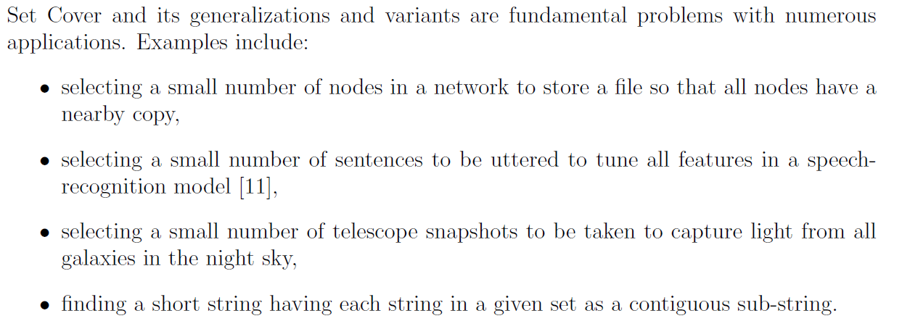
Approximation algorithm for Set-covering problem

Slide 40
Approximation algorithm for Traveling-salesman problem
Traveling-salesman problem (TSP):
Given a weighted, undirected graph, start from certain vertex, find a minimum route visit each vertices once, and return to the original vertex.
1
1
2
30
2
1
20
3
4
3

Slide 41
Approximation algorithm for Traveling-salesman problem
TSP is a NP-complete problem
There is no polynomial-time approximation algorithm with a constant approximation ratio
Another strategy to solve NPC problem:
Solve a special case

Slide 42
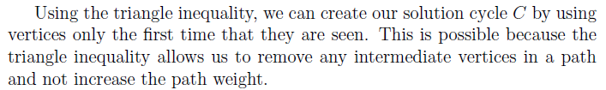
Approximation algorithm for Traveling-salesman problem
Triangle inequality:
Weight(u, v) <= Weight(u, w) + Weight(w, v)
E.g.:
If all the edges are defined as the distance on a 2D map, the triangle inequality is true
For the TSPs where the triangle inequality is true:
There is a 2-approximation polynomial time algorithm

Slide 43
Approximation algorithm for Traveling-salesman problem
APPROX-TSP-TOUR(G)
Find a MST m;
Choose a vertex as root r;
return preorderTreeWalk(m, r);

Slide 44
Approximation algorithm for Traveling-salesman problem
Can we apply the approximation algorithm on this one?
1
1
2
30
2
1
20
3
4
3
No. The triangle inequality is violated.

Slide 45
Approximation algorithm for Traveling-salesman problem
Use Prim’s algorithm to get a MST
a
d
e
b
f
g
c
h
For any pair of vertices, there is a edge and the weight is the Euclidean distance
Triangle inequality is true, we can apply the approximation algorithm

Slide 46
Approximation algorithm for Traveling-salesman problem
Use Prim’s algorithm to get a MST
a
d
Choose “a” as the root
e
b
f
g
Preorder tree walk
c
a
b
c
h
d
e
f
g
h
For any pair of vertices, there is a edge and the weight is the Euclidean distance
Triangle inequality is true, we can apply the approximation algorithm

Slide 47
Approximation algorithm for Traveling-salesman problem
Use Prim’s algorithm to get a MST
a
d
Choose “a” as the root
e
b
f
g
Preorder tree walk
c
a
b
c
h
d
e
f
g
h
The route is then…
Because it is a 2-approximation algorithm
A TSP solution is found, and the total weight is at most twice as much as the optimal one

